Slide 2

1
9
Lesson 19
Set II-Operation on Sets
And Venn Diagram

Slide 3
Part 1
Operation on Sets

Slide 4
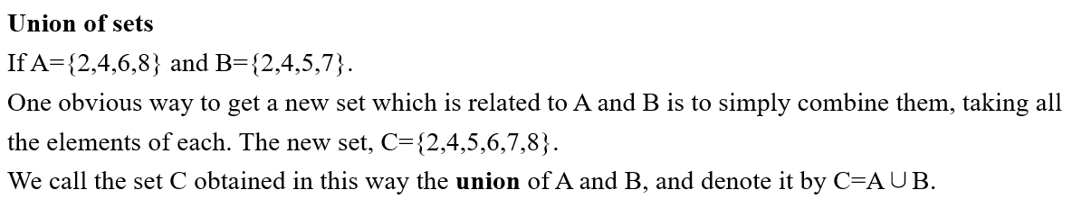
Lead in

Slide 5
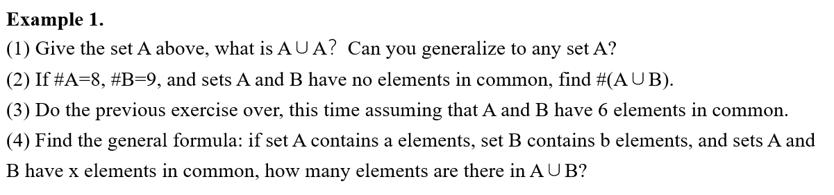

Example

Slide 6
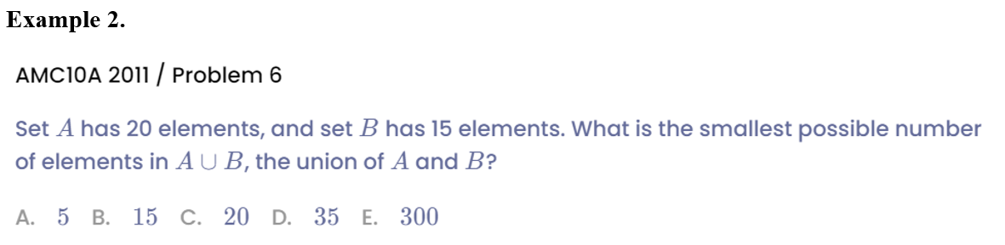
Example

Slide 7
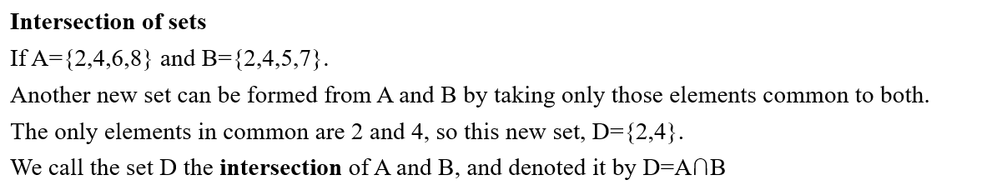
Lead in

Slide 8
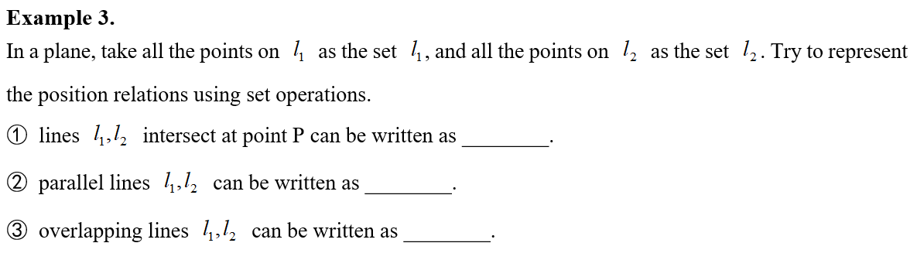
Example

Slide 9
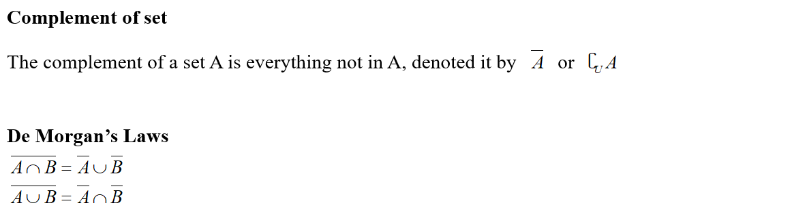
Lead in

Slide 10
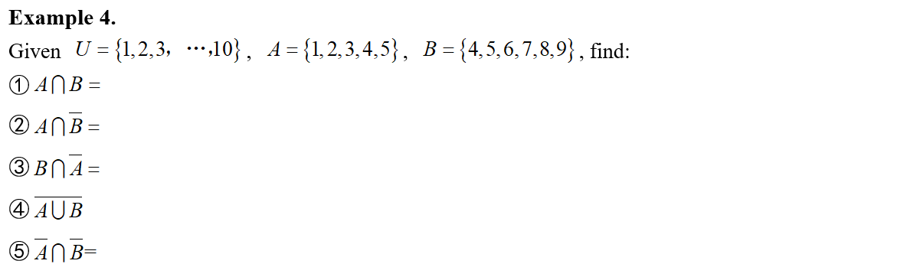
Example

Slide 11
Example

Slide 12
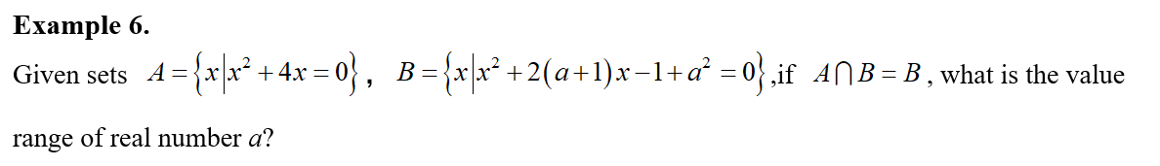
Example

Slide 13
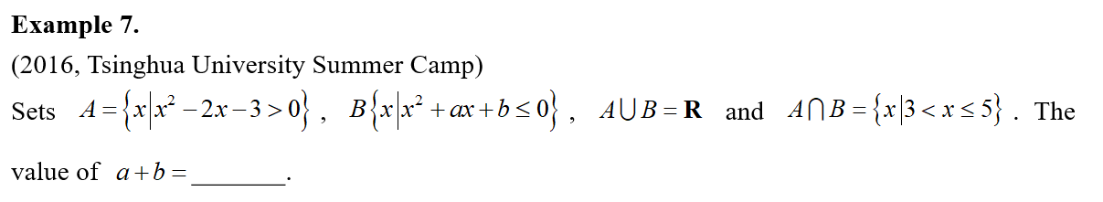
Example

Slide 14
Part 2
Venn Diagram

Slide 15
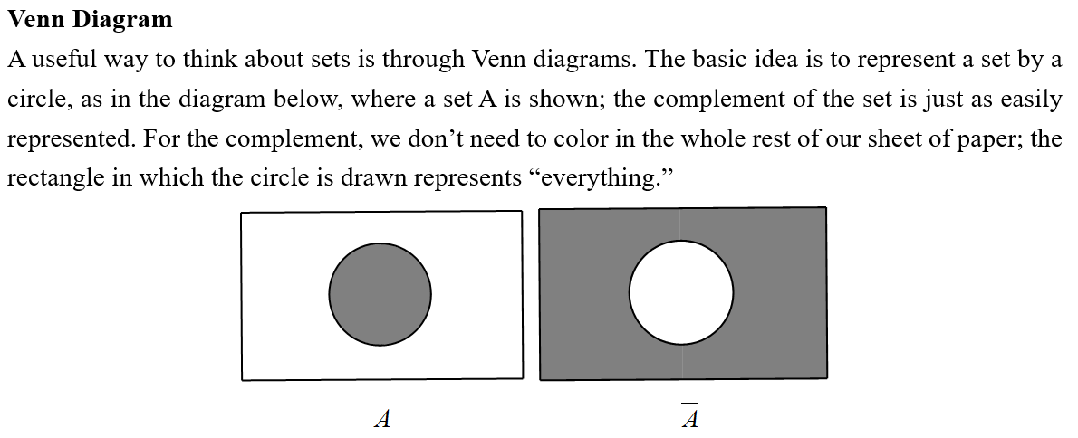
Lead in

Slide 16
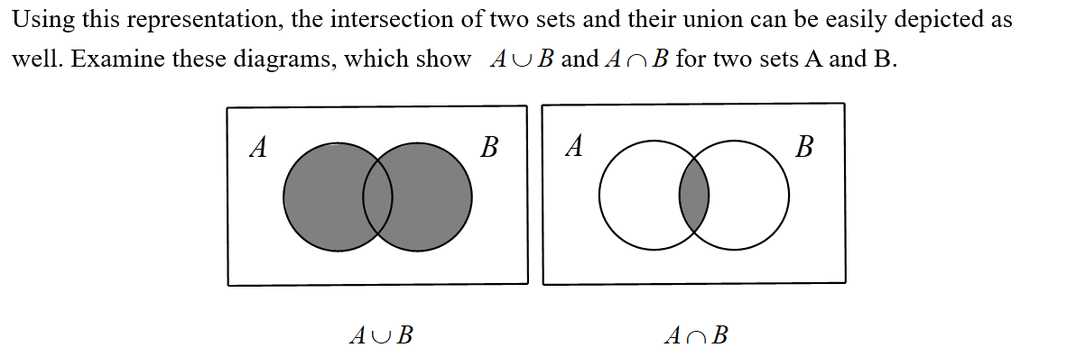
Lead in

Slide 17
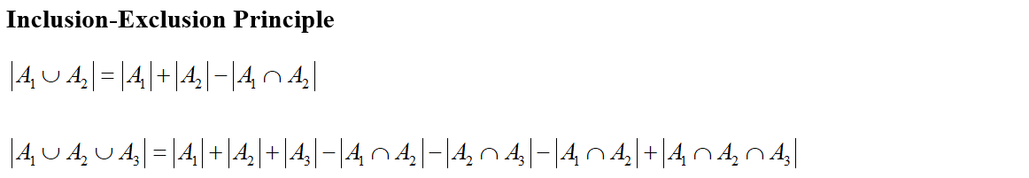
Lead in

Slide 18
Example

Slide 19
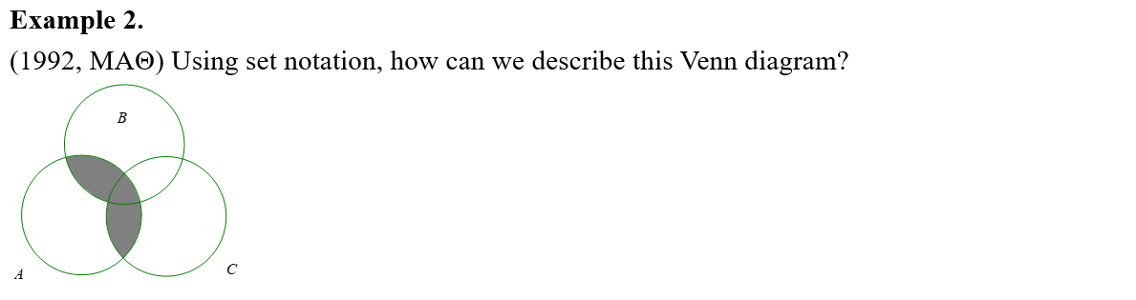
Example

Slide 20
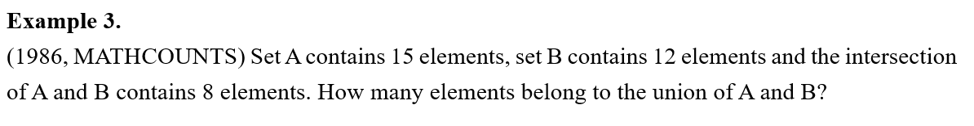
Example

Slide 21
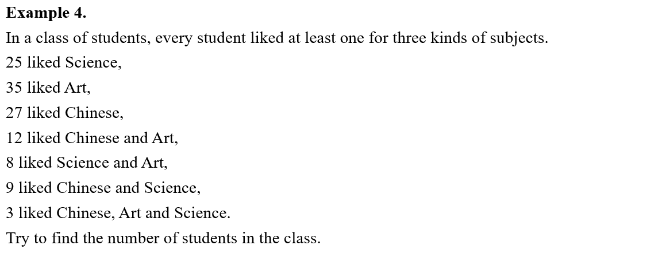
Example

Slide 22
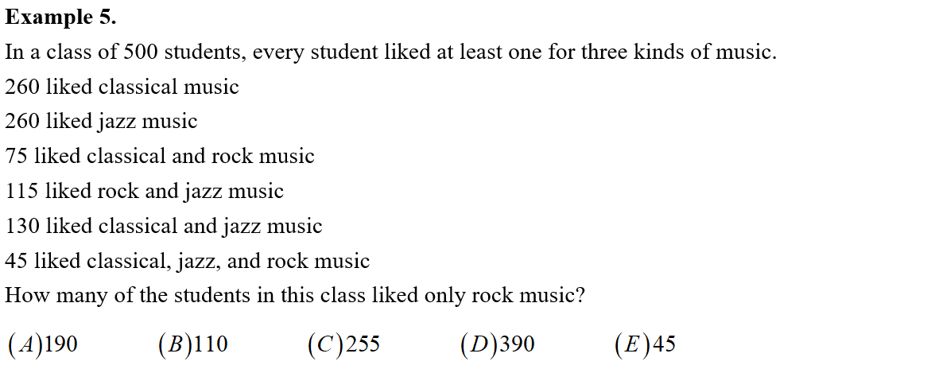
Example

Slide 23
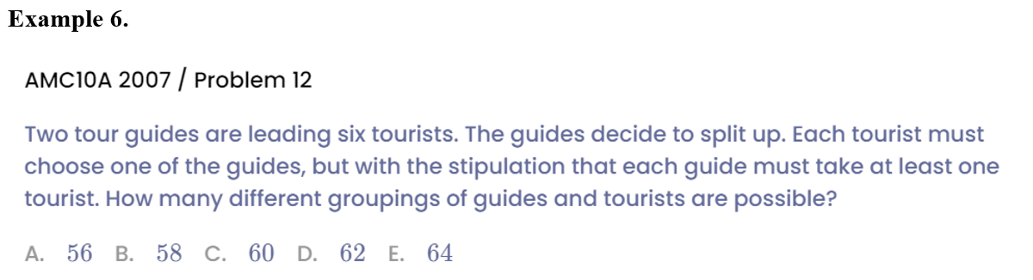
Example

Slide 24
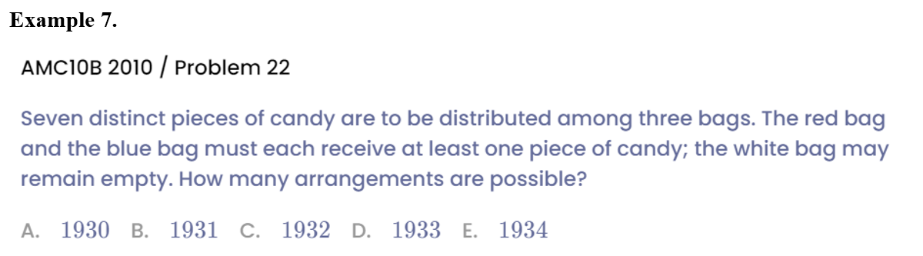
Example

Slide 25
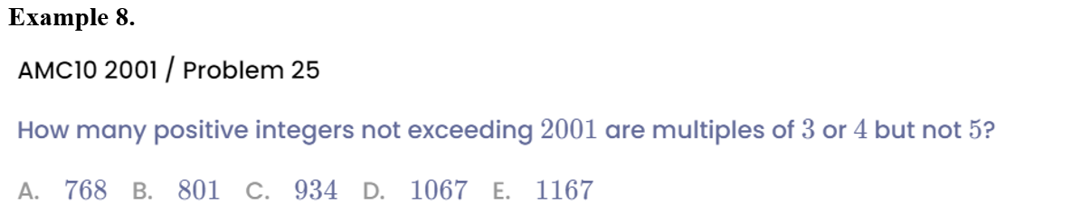
Example

Slide 26
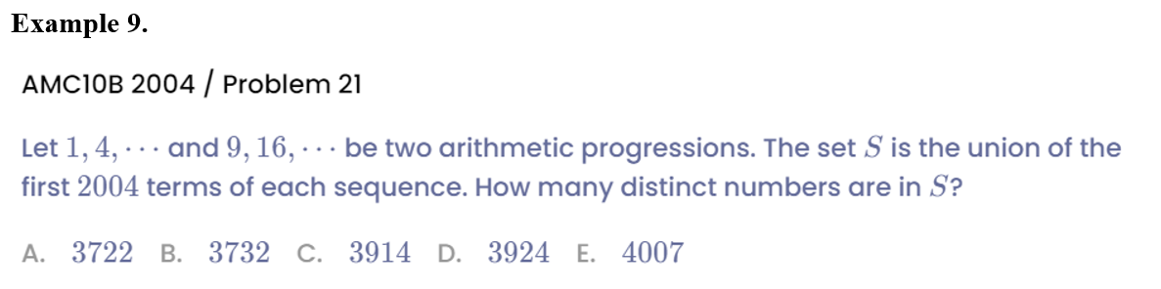
Example

Slide 27
See You Next Time!

